Slide 1
Final Report for Database Management
Guofeng Tang, Jiacheng Xue

Slide 2
Work task allocation
Jiacheng Xue: All front-end work, database design, and functional testing.
Guofeng Tang: All backend work, database design, documentation writing.

Slide 3
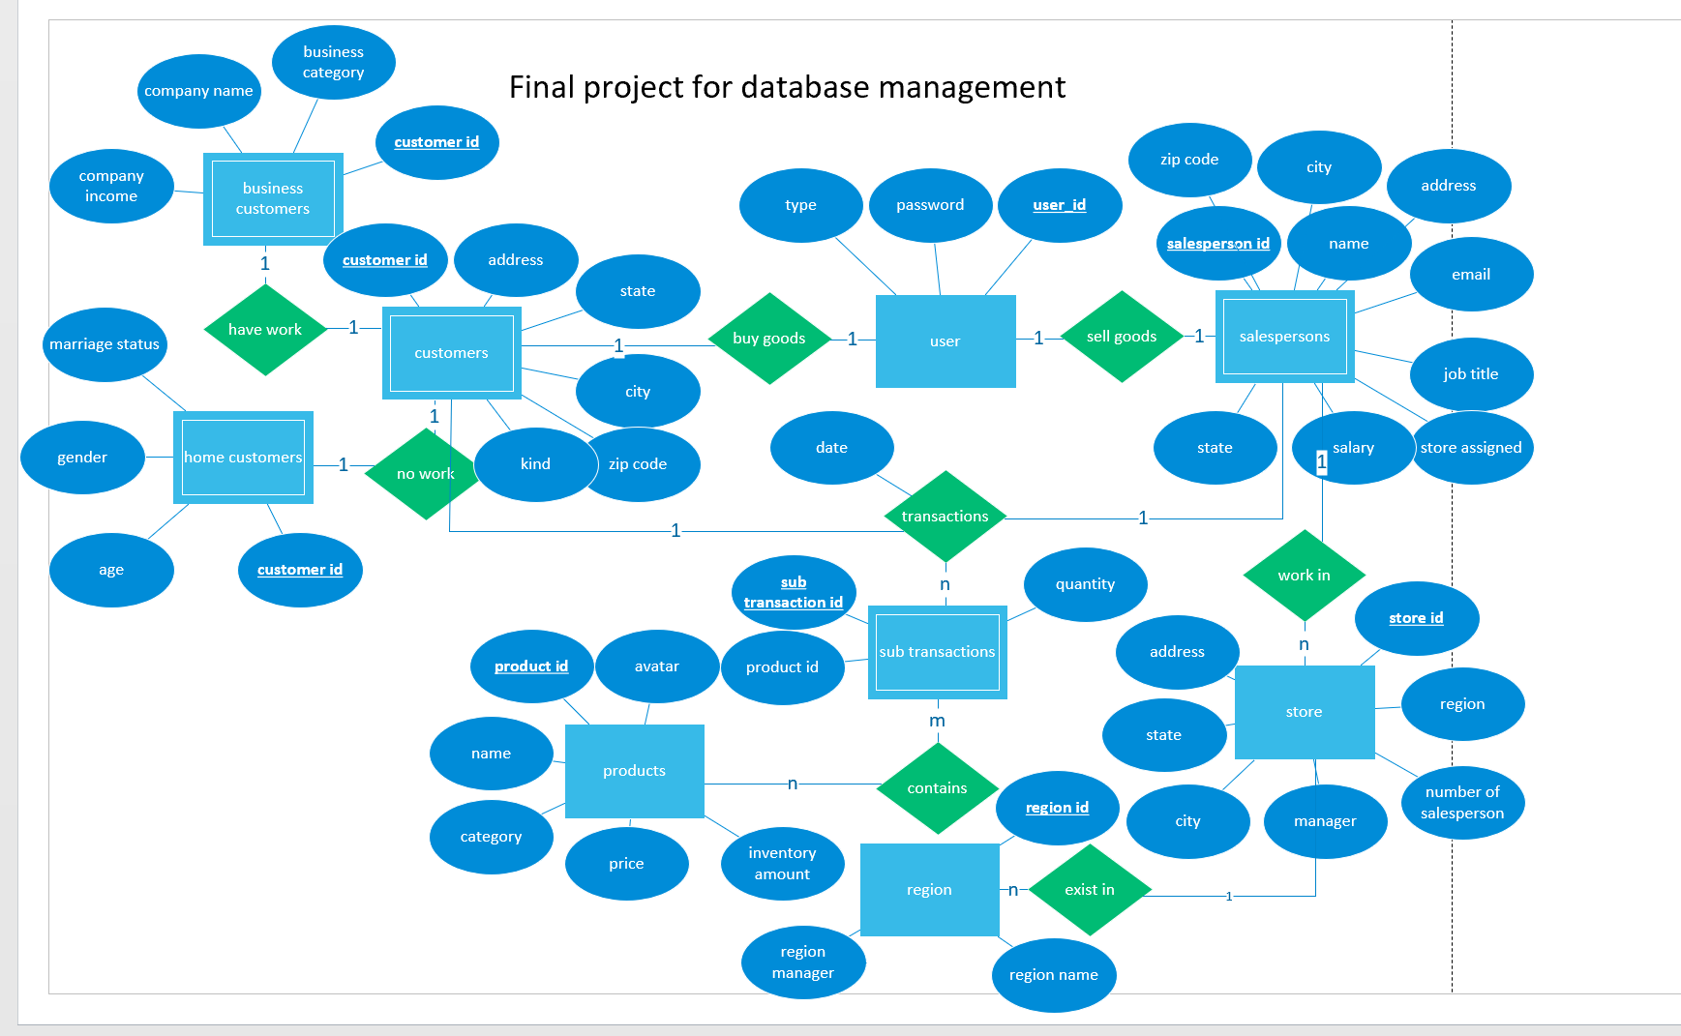
E-R TABLE
Notes:
First, Let me introduce the database created by our group. The entity sets are user, customers, business customers, home customers, salespersons, store, region, sub transactions and products. User contains user_id, password and type. Type can only be input as “customer” or “salesperson”. Customers contains address information and the kind. Kind can only be input as “business” and “home”, so that we can judge if the customer is business customers or home customers. Salespersons incoude the address information, name, email, job, salary and store. The store information is stored in the store table, with address information, manager ,number of salesperson and region. The region information is stored in region table, containing region manager, region name and region id. And we have sub transactions and products for us database to create the transactions.

Slide 4
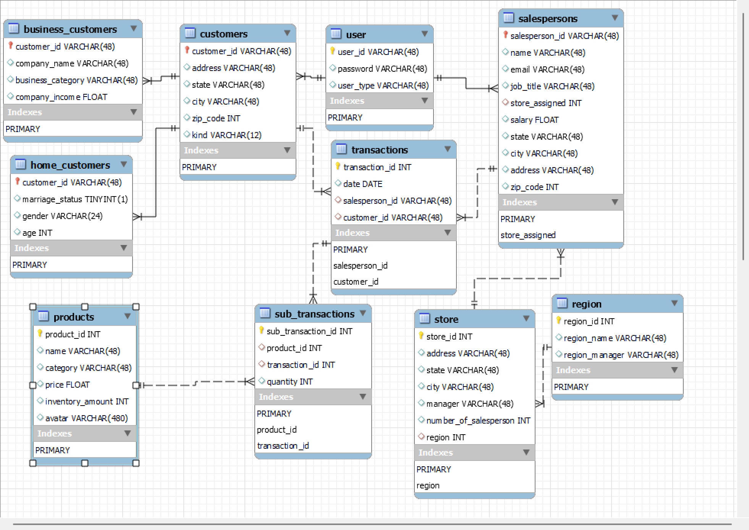
relational schema
Notes:
Use the E-R graph, we create the relational schema as the graph shows. The light bulb sign here represents the key, these red values are foreign key. Except the main table required in the project description, we have user, sub transactions, business customers and home customers. The user table is used to uniformly manage all registered user information, including customers and salespersons. Sub transactions are created to allow the main transactions to store multiple goods information at the same time. For example, if we only use the transactions, we will have multiple transaction id with the same “date”, “salesperson id”, “customer id” information for different products. But if we have the sub transactions, we can avoid this duplicate information. Business customers table and home customers table are used to show the information of customers in different types.

Slide 5
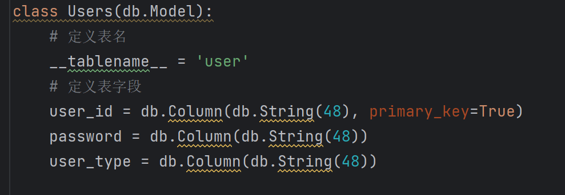
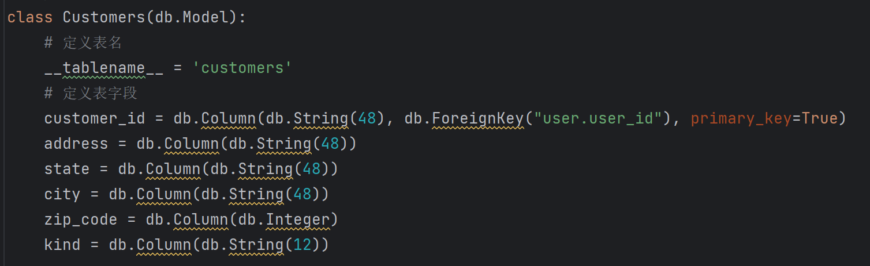
create the relational schema

Slide 6
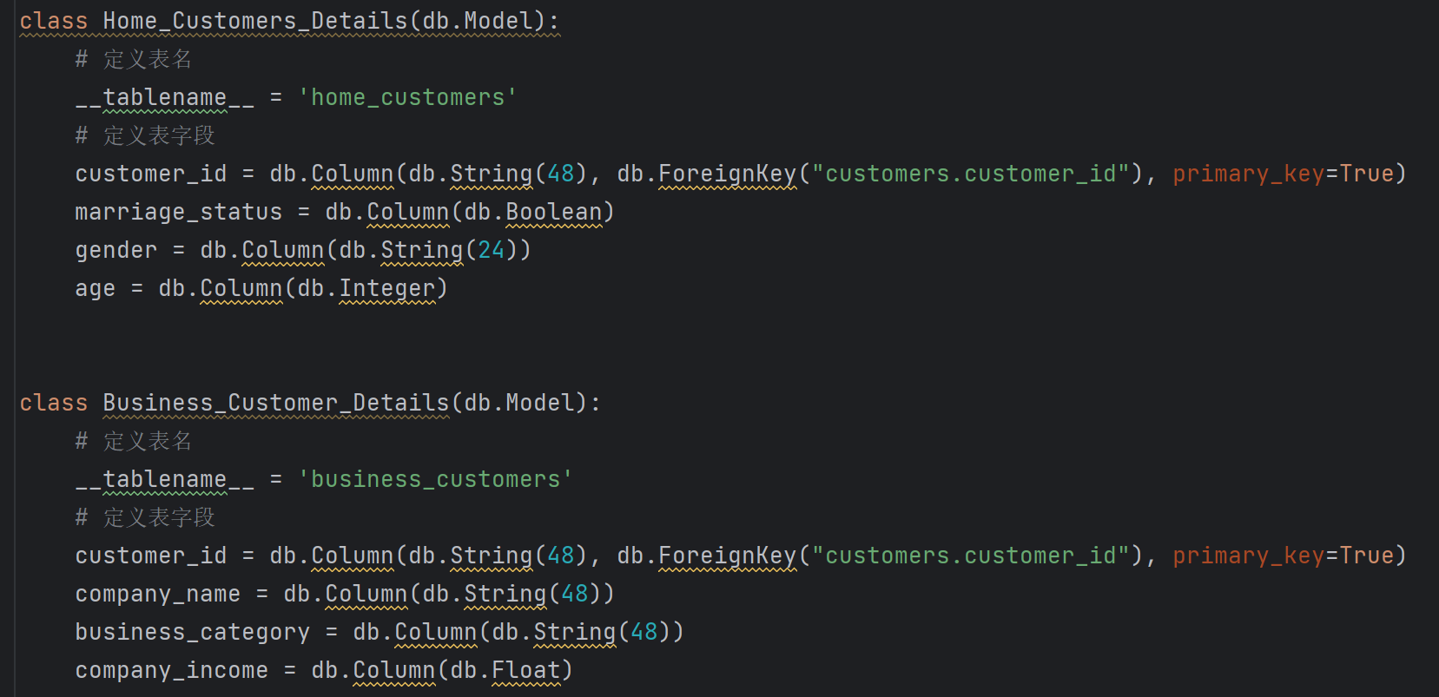
create the relational schema

Slide 7
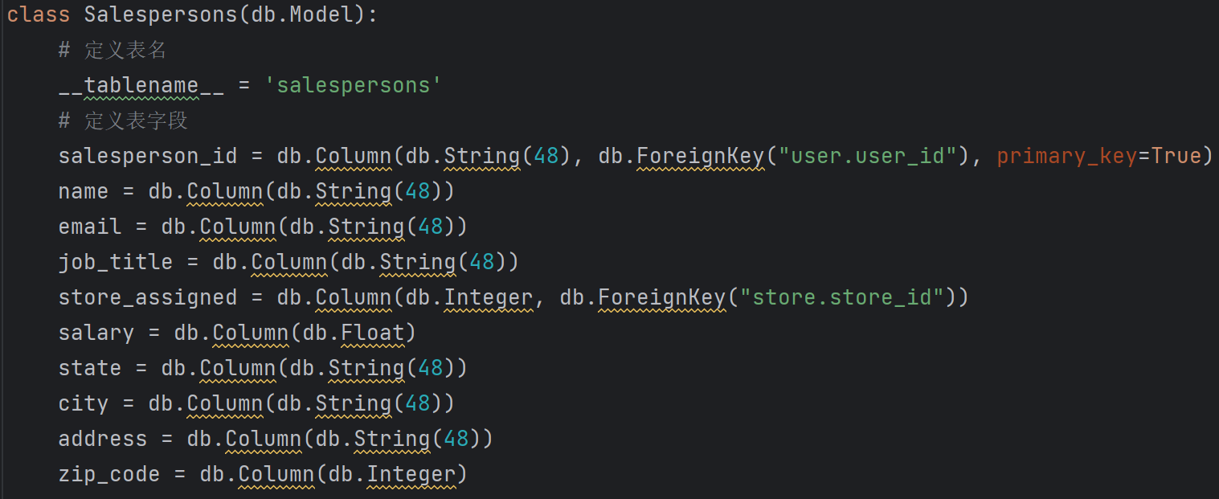
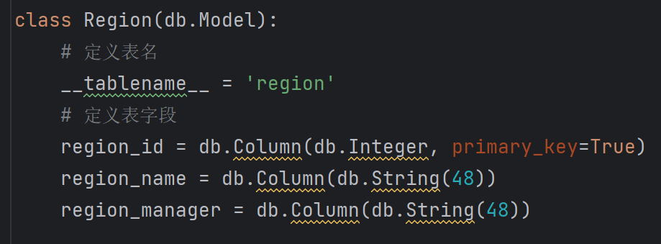
create the relational schema

Slide 8
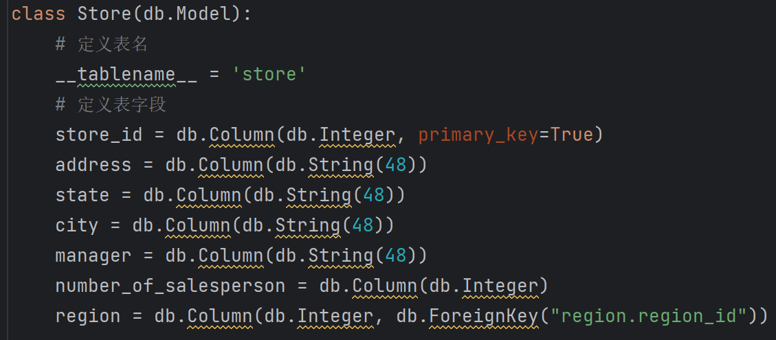
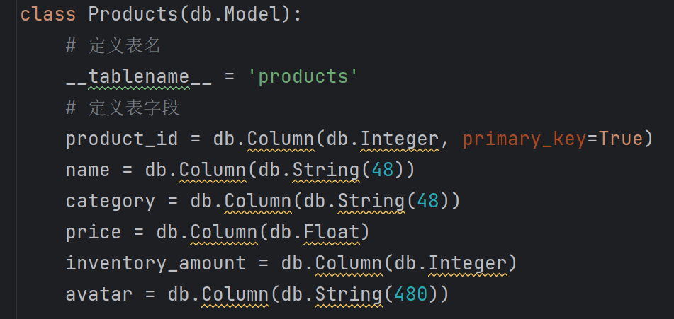
create the relational schema

Slide 9
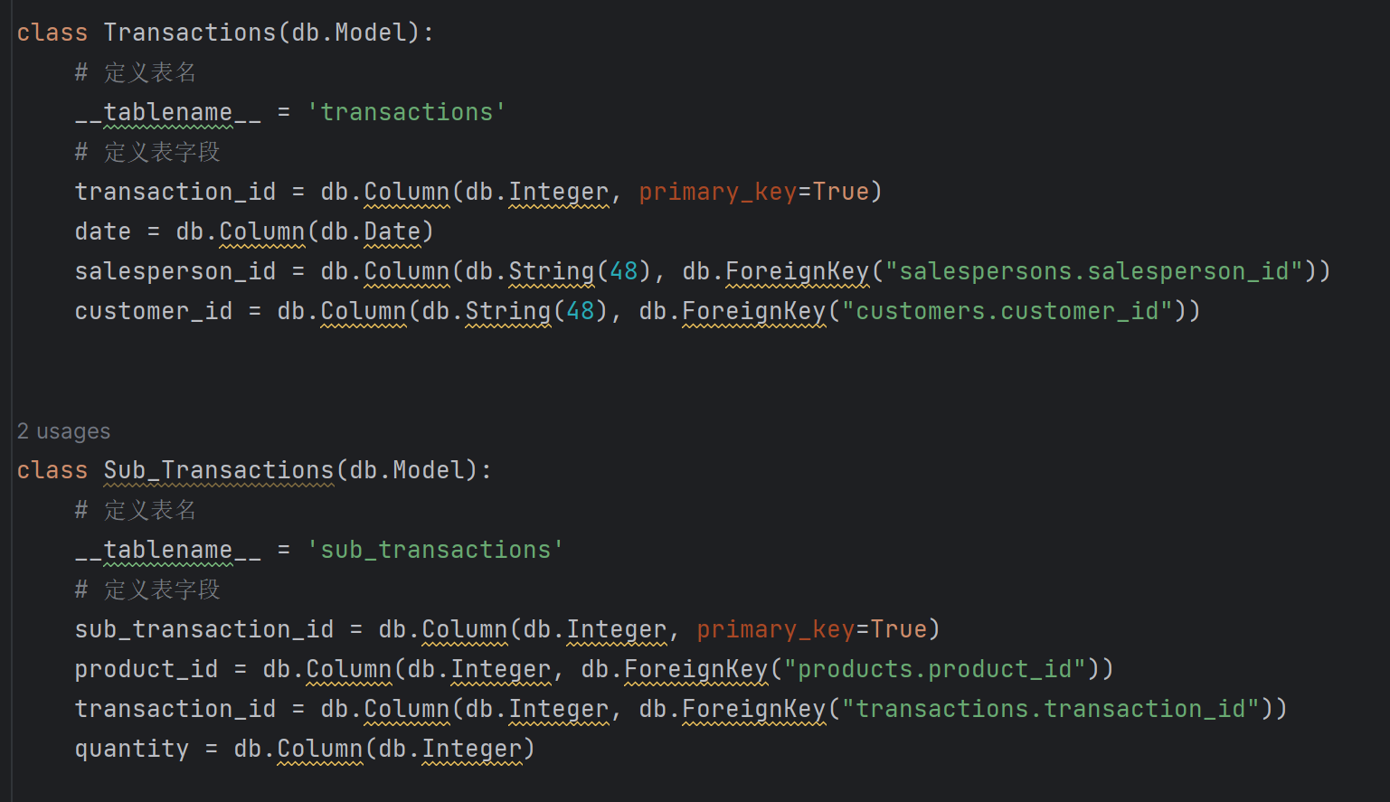
create the relational schema
Notes:
Because the relationship does not contain transitive dependencies and partial dependencies on the primary key, id is the only key for each table. Then the Normal Form is BCNF.

Slide 10
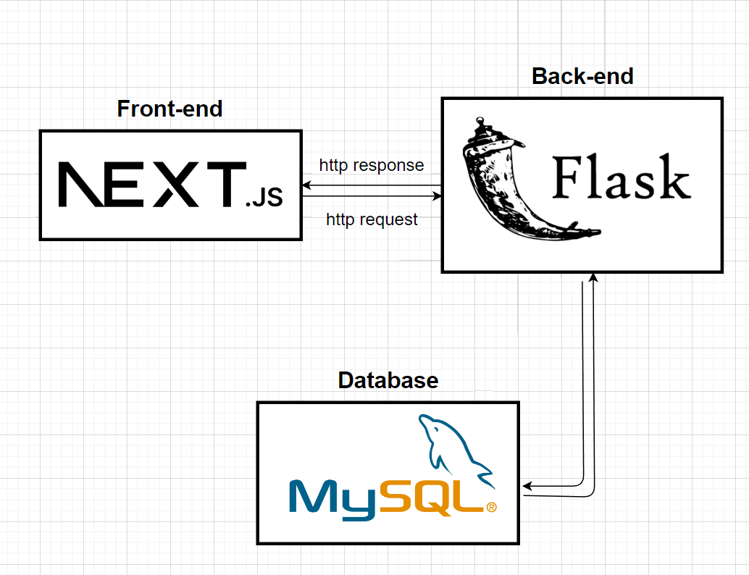
System Implementation
Front-end and back-end connection
Notes:
We use next.js as frontend framework and flask as backend. We use mysql as database and connect it with backend. Front-end request data from backend through http protocol.

Slide 11
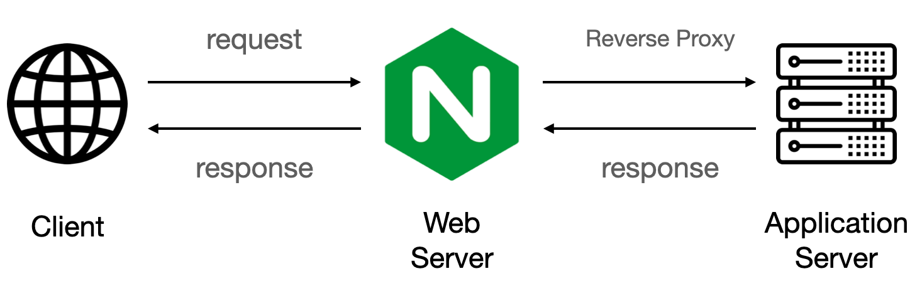
System Implementation
Front-end and back-end connection
Notes:
More specifically, we have deployed our app behind nginx, which make user able to access both frontend and backend under same domain.

Slide 12
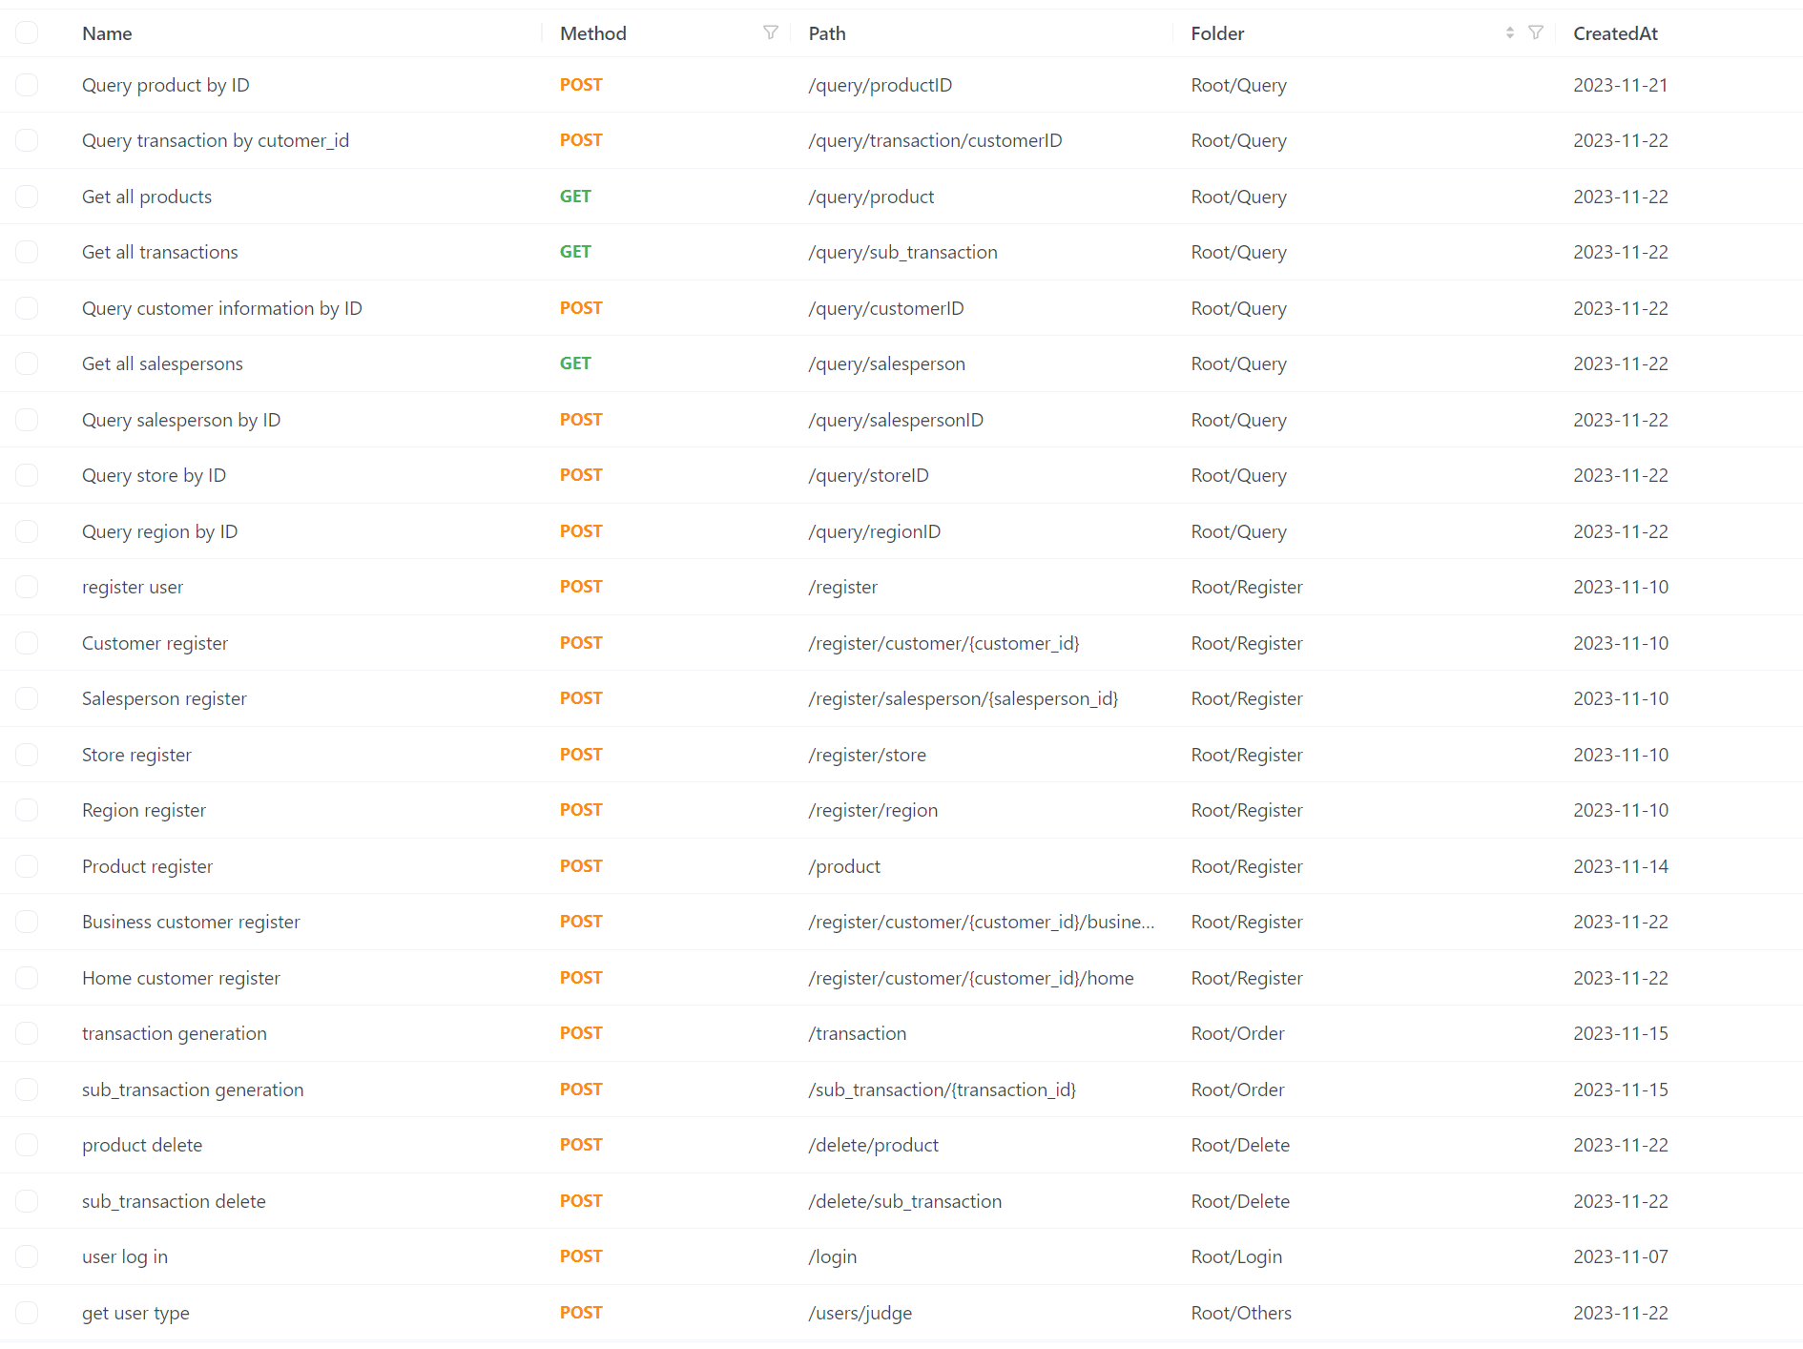
API
API docs
Notes:
To manage complex interfaces, we use API documentation to track the connection of the front-end and back-end.

Slide 13
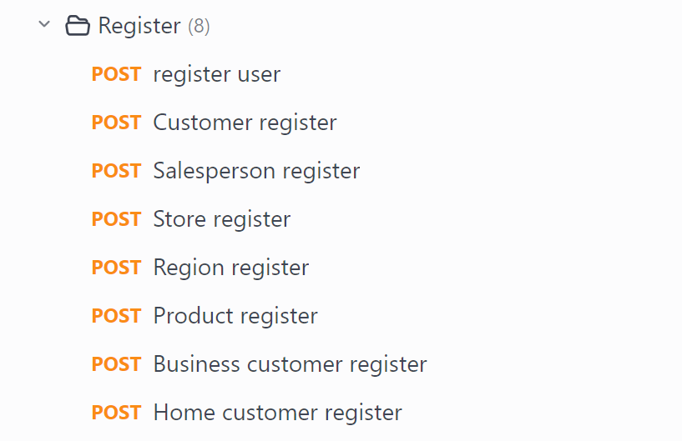
The function assumption for system
Register function
Notes:
This is the documentation we wrote before coding. First the function we want to create is importing data into database. Including user, customer, salesperson, store, region, product business customer and home customer.

Slide 14
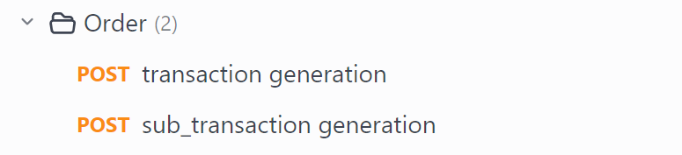
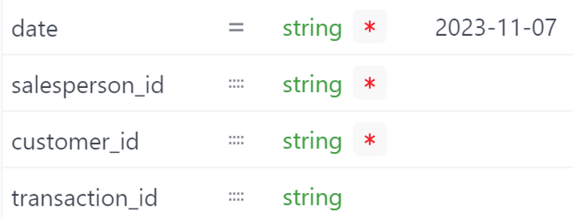
The function assumption for system
order function
Notes:
Then is the main function for our system, the order function. Including transaction and sub transaction. In transaction generation, customer create a transaction and select the salesperson. Then the system will get the date, customer id and transaction id itself. In sub transaction generation, customers will select multiple products and their quantities. The system will create a sub transaction id, then connect the sub transaction to the main transaction.

Slide 15
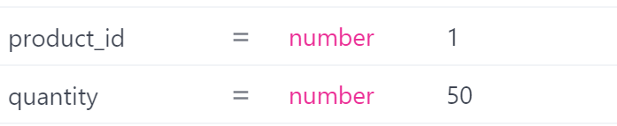
The function assumption for system
order function
Notes:
Then is the main function for our system, the order function. Including transaction and sub transaction. In transaction generation, customer create a transaction and select the salesperson. Then the system will get the date, customer id and transaction id itself. In sub transaction generation, customers will select multiple products and their quantities. The system will create a sub transaction id, then connect the sub transaction to the main transaction.

Slide 16
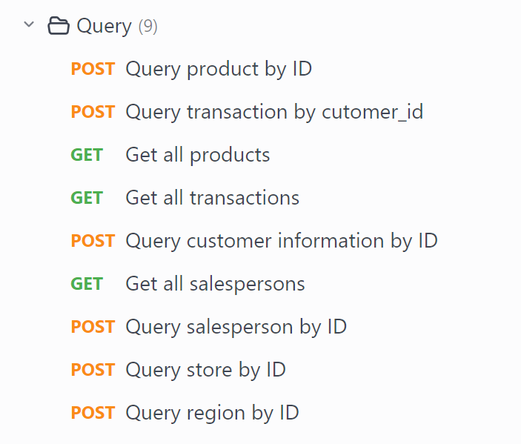
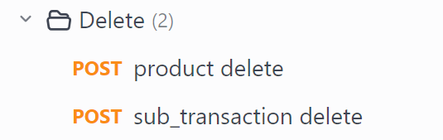
The function assumption for system
query function
Notes:
Next are query function. Including three ‘GET’ function to get all information from table. And three function to get information by ID. Of course including customer ID and salesperson ID.

Slide 17
The function assumption for system
delete function
Notes:
Then, is delete function. In particular, I will create a function in sub transaction deletion. When all sub transaction under the main transaction bound to the sub transaction are deleted, the main order will also be deleted.

Slide 18
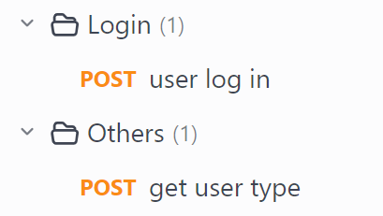
The function assumption for system
other function
Notes:
Last are other function. Including log in for customer user and salesperson user. And a get user type function, in order to judge whether user is customer or salesperson.

Slide 19
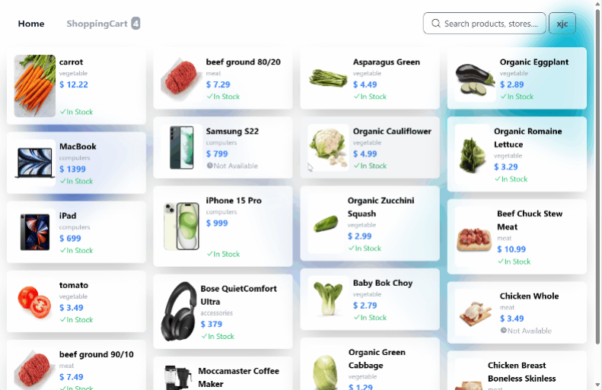
Front-end Design
Browse products
Notes:
Customers are able to browse available products in our system, and shopping cart can temporarily store transaction info before submit order. Customer can get information about price, name and other product information

Slide 20
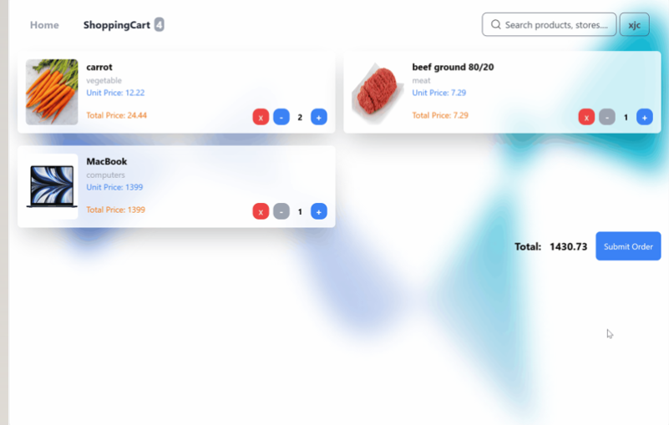
Front-end Design
Make orders
Notes:
Customers can submit order in the shopping cart page, and customer need to offer a salesperson id who have authorized this order.

Slide 21
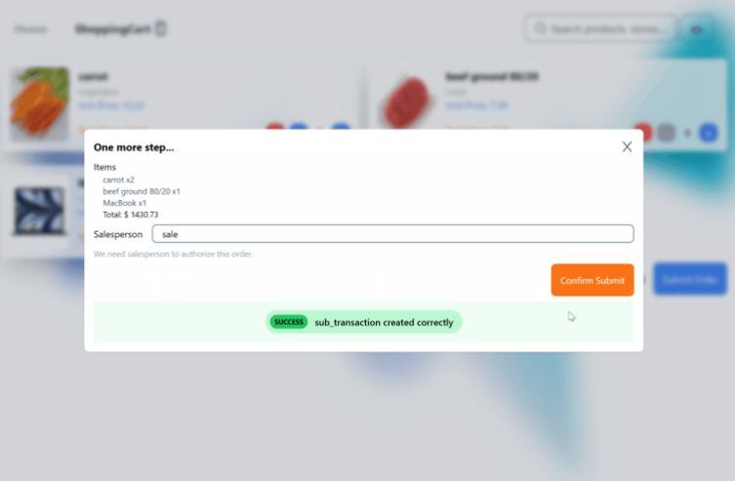
Front-end Design
Make orders
Notes:
Customers can submit order in the shopping cart page, and customer need to offer a salesperson id who have authorized this order.

Slide 22
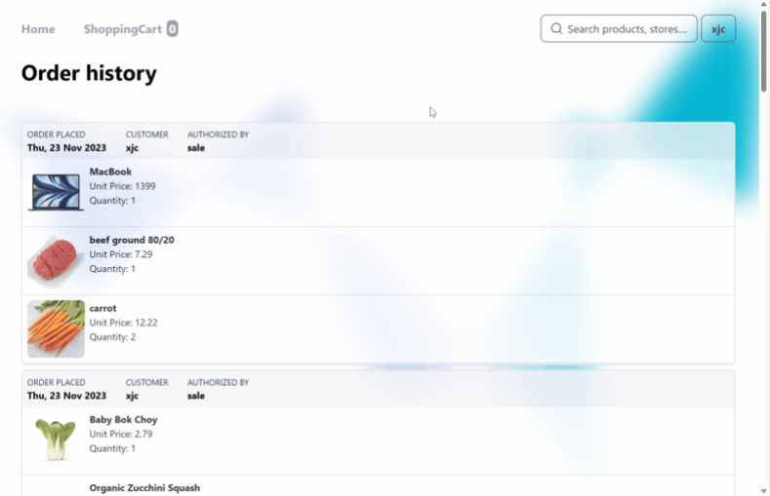
Front-end Design
Check orders
Notes:
Customer can check their order history in this page, all required data are fetched from backend, which is a aggression query.

Slide 23
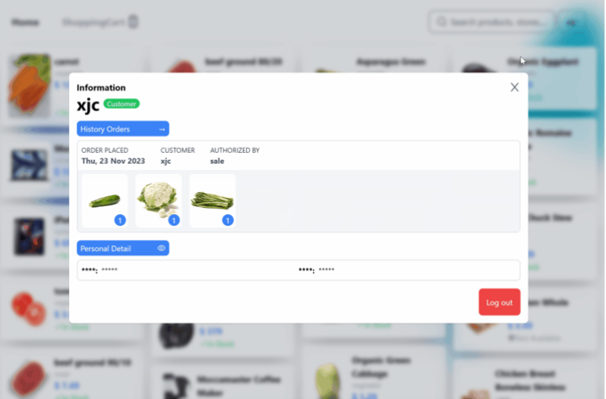
Front-end Design
User Info
Notes:
Customers can check their personal information if they have logged in the system. The user identity, e.g. Customer or Salesperson are also marked next to userid.

Slide 24
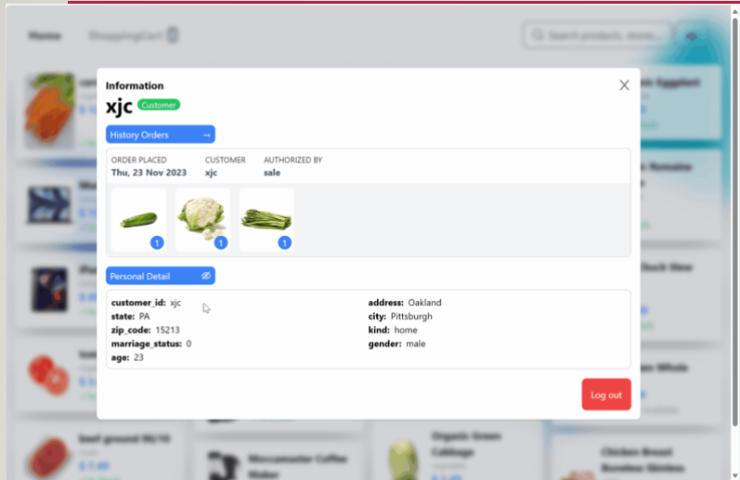
Front-end Design
More User Info
Notes:
More detailed information including income, gender etc. can be seen as well.

Slide 25
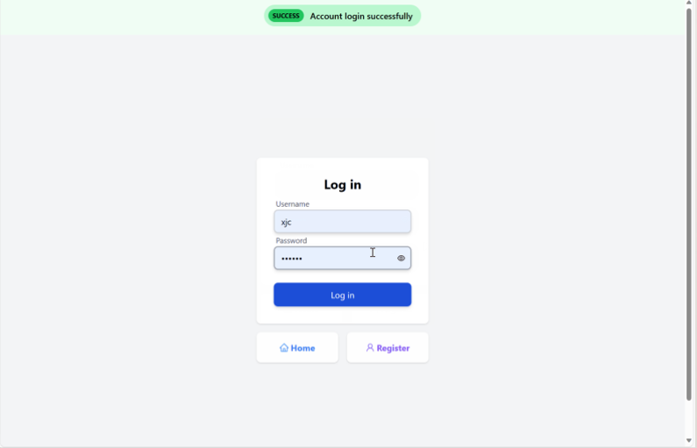
Front-end Design
User Login
Notes:
Customers are able to login and register into our system

Slide 26
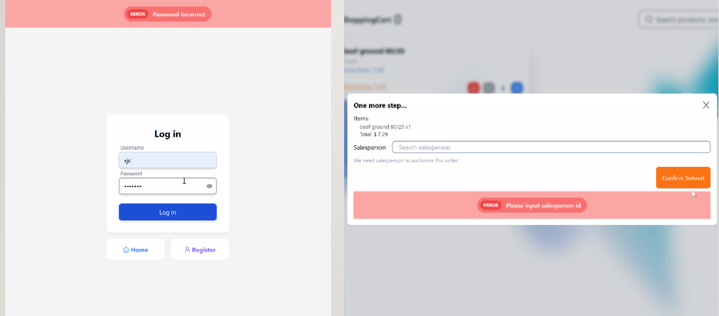
Front-end Design
Error Handling
Notes:
Our system is robust, we handle errors both in front-end and backend.

Slide 27
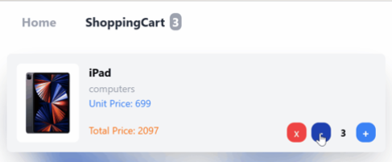
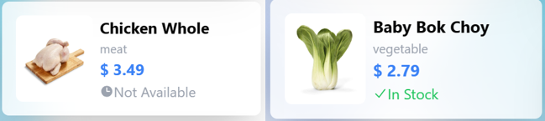
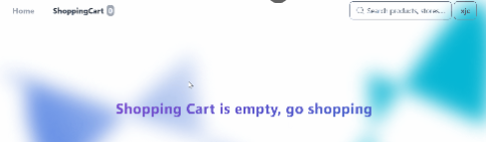
Front-end Design
More design details
Notes:
Our frontend design contains more interesting details, for example, you are not able to decrease product number if number is less than 1, the shopping cart page will not show if there’s noting in the cart. Also, is currently number in the inventory is less than 1, we are showing out of stock sign to users.

Slide 28
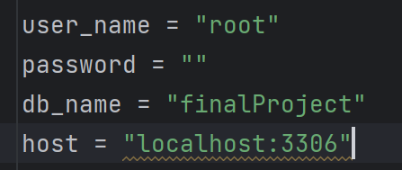
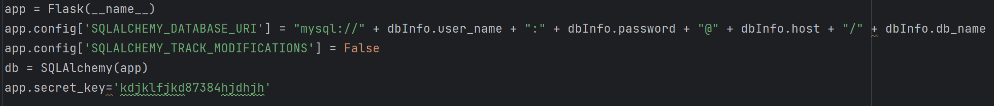
Backend connection to database
Notes:
In backend, I use the python + flask + mySQL to connect to the database. In order to let our front-end use his database, I create a file called “dbinfo.py”, to change the main information to connect to the mySQL.

Slide 29
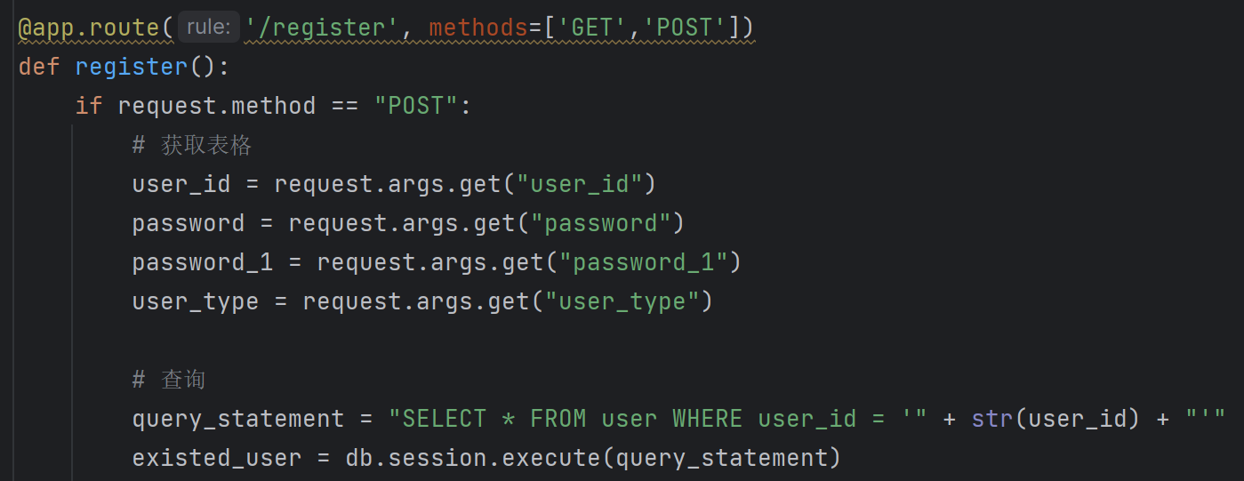
Backend code display
register
Notes:
First, I use the request.args.get() to get information from the front-end. Then, using the SQL to write the query statement, and use execute() function to put the SQL query into the mySQL system. After that, I handled some error situations such as inputting null values, invalid input values, etc. At last, I write the input query statement and insert the data into the table in the database.

Slide 30
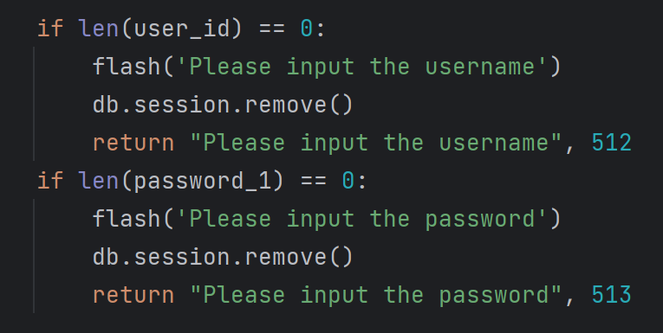
Backend code display
register
Notes:
First, I use the request.args.get() to get information from the front-end. Then, using the SQL to write the query statement, and use execute() function to put the SQL query into the mySQL system. After that, I handled some error situations such as inputting null values, invalid input values, etc. At last, I write the input query statement and insert the data into the table in the database.

Slide 31
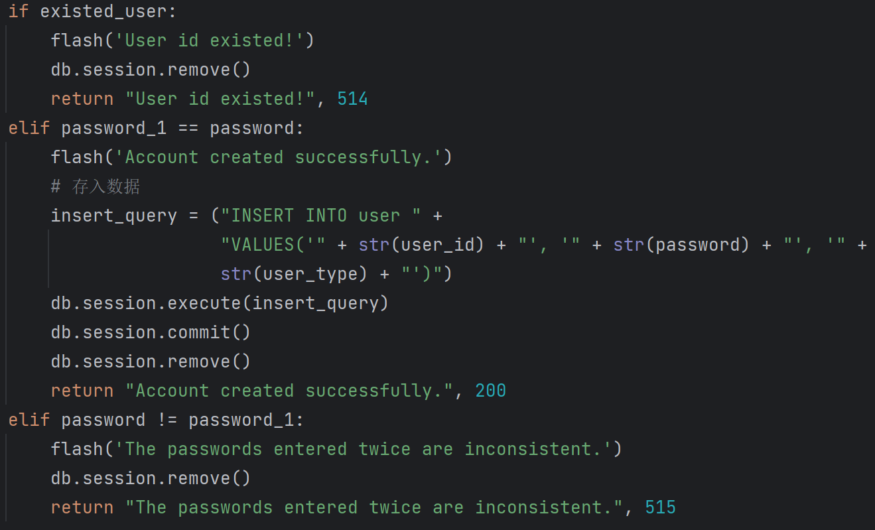
Backend code display
register
Notes:
First, I use the request.args.get() to get information from the front-end. Then, using the SQL to write the query statement, and use execute() function to put the SQL query into the mySQL system. After that, I handled some error situations such as inputting null values, invalid input values, etc. At last, I write the input query statement and insert the data into the table in the database.

Slide 32
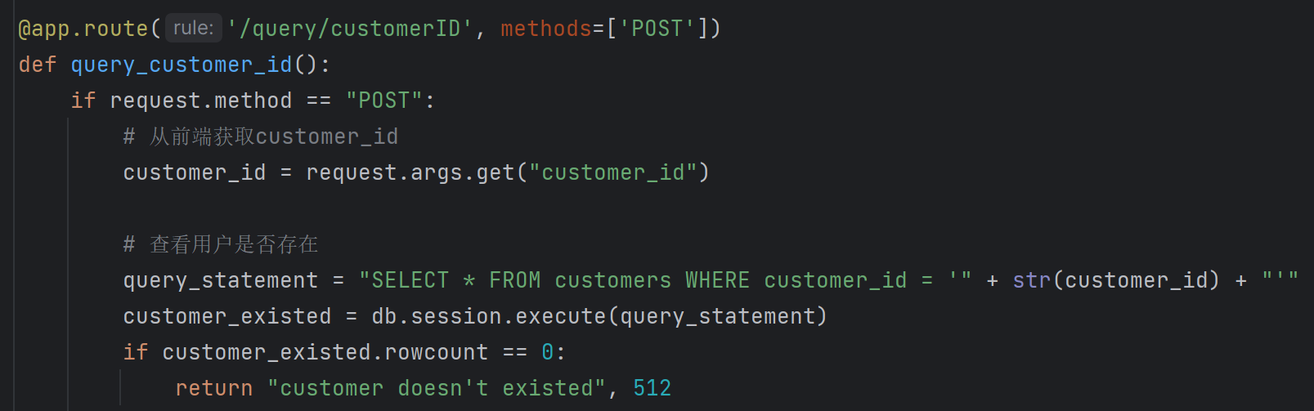
Backend code display
query
Notes:
I select a example that use the customer ID to query the information of business customer or home customer. First, I handled some special situations such as inputting null values, user non-existence, etc. If there are no more errors, I first query the information in the customers table. Then I use to kind element to help me judge if customer is a business customer or home customer.

Slide 33
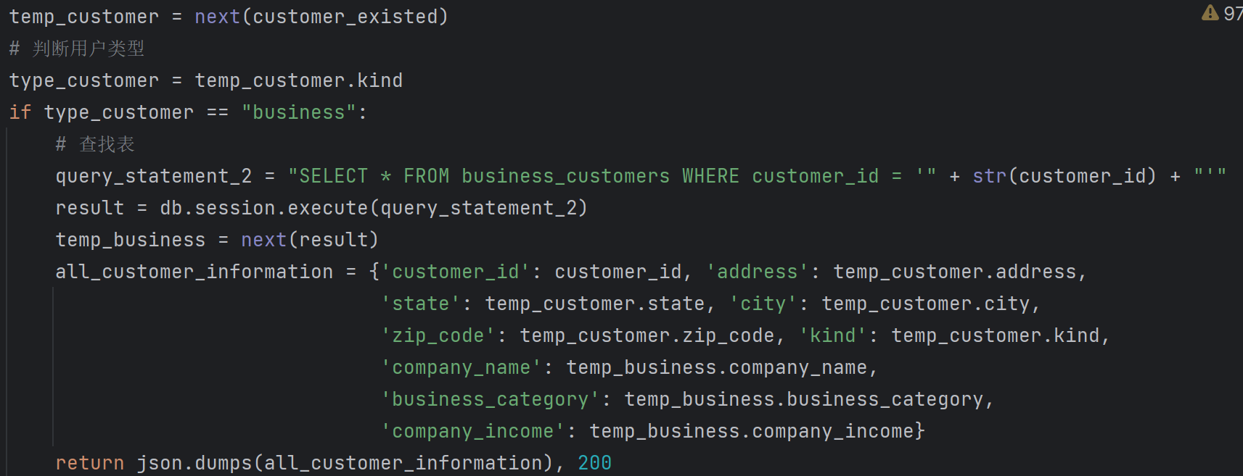
Backend code display
query
Notes:
I select a example that use the customer ID to query the information of business customer or home customer. First, I handled some special situations such as inputting null values, user non-existence, etc. If there are no more errors, I first query the information in the customers table. Then I use to kind element to help me judge if customer is a business customer or home customer.

Slide 34
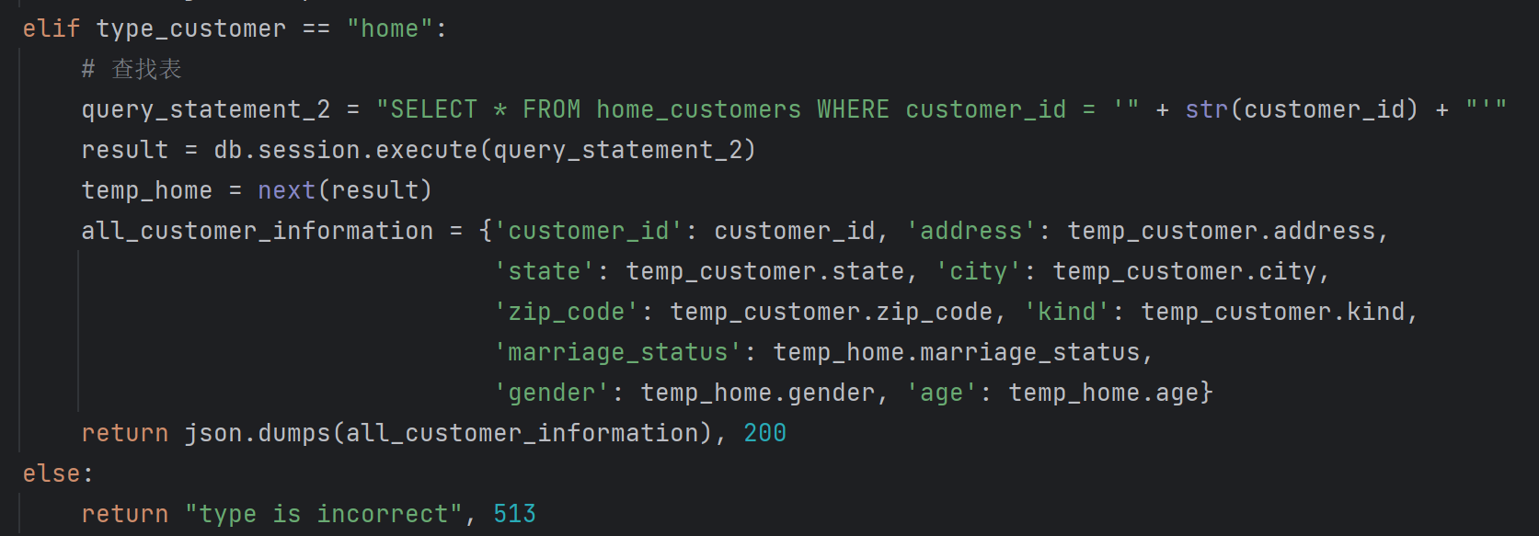
Backend code display
query
Notes:
I select a example that use the customer ID to query the information of business customer or home customer. First, I handled some special situations such as inputting null values, user non-existence, etc. If there are no more errors, I first query the information in the customers table. Then I use to kind element to help me judge if customer is a business customer or home customer.

Slide 35
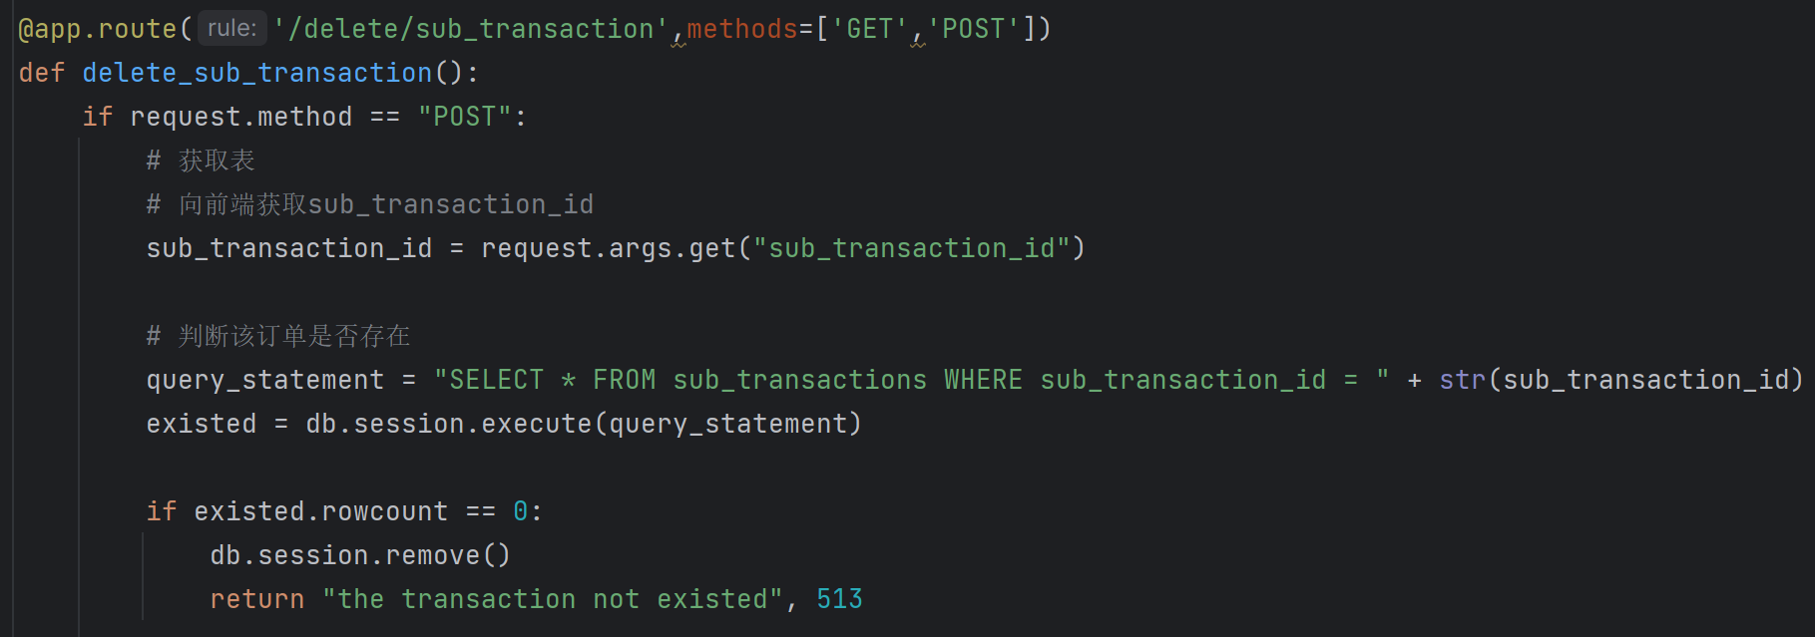
Backend code display
delete
Notes:
I choose to show the example of deleting the sub transaction. First, I get the sub transaction id from the front-end, and use the DDL query statement to judge if this sub transaction exist or not. Then I try to delete this sub transaction. If there is no sub transaction with the same main transaction id in the table, I will delete the main transaction.

Slide 36
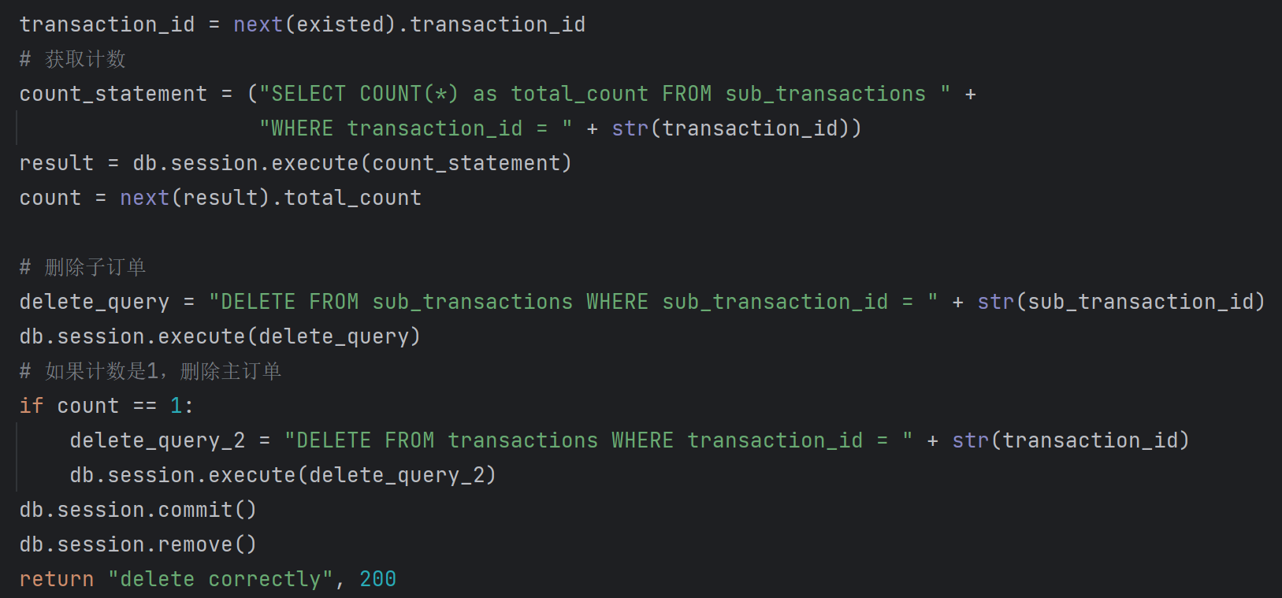
Backend code display
delete
Notes:
I choose to show the example of deleting the sub transaction. First, I get the sub transaction id from the front-end, and use the DDL query statement to judge if this sub transaction exist or not. Then I try to delete this sub transaction. If there is no sub transaction with the same main transaction id in the table, I will delete the main transaction.

Slide 37
detectable errors
In register, I detect if the input is null value or not.
In particularly, I detect whether the username has been registered. And whether the repeated password is same as the original one.

Slide 38
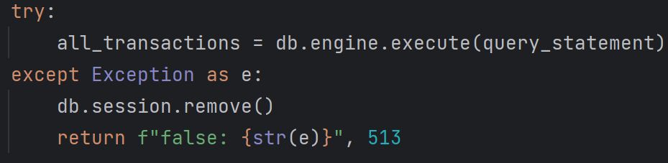
detectable errors
In delete and query function, I will detect whether the id is existed or not.
And in function that have multiple DDL statement. I will detect the database rollback information if there is any errors occur in mySQL.

Slide 39
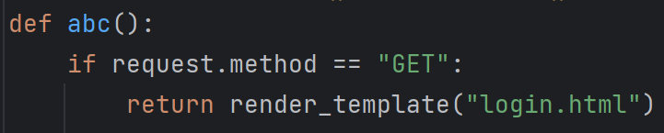
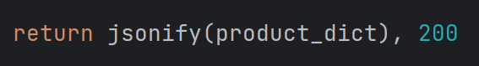
Problems solved during coding
Notes:
The first error is that the backend doesn’t return in a valid type. Because when using flask to do the backend and front-end, we need to use the render_template() function to connect the backend and front-end. However, we use other methods except flask in front-end. So that I change to use the jsonify() function to change our information into json type, and pass it with the status code from backend to front-end.

Slide 40
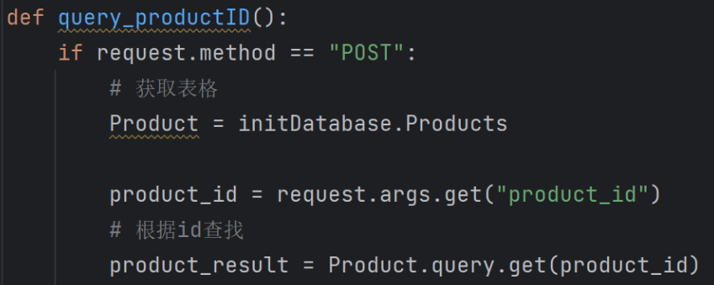
Problems solved during coding
Notes:
The second error is the QueuePool overflow. I found that when I use SQLAlchemy methods to operate database, when the front-end stop this operation, python won’t disconnect the backend and database. However, when I use the SQL query statement directly, this problem is solved. So I change the query, insert and delete methods in our code.

Slide 41
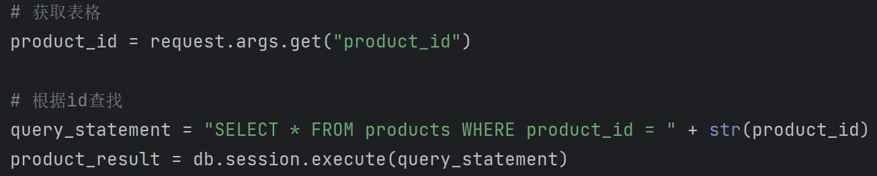
Problems solved during coding
Notes:
The second error is the QueuePool overflow. I found that when I use SQLAlchemy methods to operate database, when the front-end stop this operation, python won’t disconnect the backend and database. However, when I use the SQL query statement directly, this problem is solved. So I change the query, insert and delete methods in our code.

Slide 42
Problems solved during coding
Notes:
Next, when I try to get the product_id value in the product result, it shows this error. I checked the information and found out that the ‘LegacyCursorResult’ is a Iterator type for database.

Slide 43
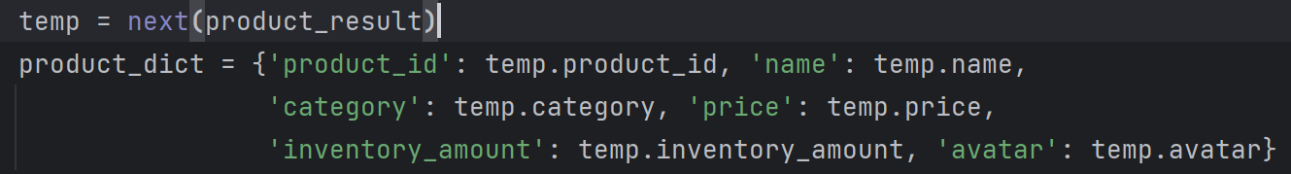
Problems solved during coding
Notes:
Next, when I try to get the product_id value in the product result, it shows this error. I checked the information and found out that the ‘LegacyCursorResult’ is a Iterator type for database. Then I use the function next() to get the data from the iterator to solve this error.

Slide 44
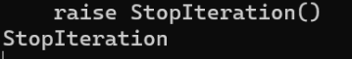
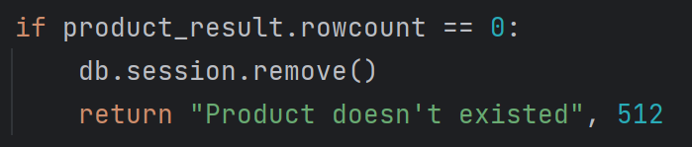
Problems solved during coding
Notes:
Next error is “raise StopIteration()”. Because I try to use the next() function on a iterator that have nothing in it. So I also change the method to detect the none value to solve this error.

